Slide 1
Daily Power Consumption
by – Onkar Patil
26 Nov 2021

Slide 2
Summary
This presentation is to understand complete Data Science cycle for Regression problem using Deep Learning, here a daily power consumption estimation is analyzed.
In upcoming slides I am going to discuss about the steps that need to be followed, approaches and the result.
Lets begin…

Slide 3
Steps in Data Science Life Cycle
Data Collection + Pre-processing + Feature Engineering
Model Selection/Preparation + Training and Testing
Deploying best model and consuming (Using for actual production)

Slide 4
EDA – Data pre-processing & Feature Engineering
Here data we choose is from UCI repo - https://archive.ics.uci.edu/ml/machine-learning-databases/00235
It contains data of power consumption for every minute from 2006 to 2010, containing around 2 million entries. To make it easy to handle I converted minute consumption to daily consumption data, making it 1442 entries.
Now we have Time Series Data lets use some Deep learning models to analyze it.
Note– Problems like missing values and structuring data is explained in Jupiter notebook

Slide 5
Approach
Approach 1: Create a lagged features, for example : [ Day of week, day of month, month, year, weekend or weekdays ] This kind of features are very useful when applying linear regression as they help to capture the phase change. We can use DNN (Deep Neural Network) on top of it.
Approach 2: Create a window features, for example : [window element, target], [[10,20,30],40]. Here window size should be comparable to time series season. Then apply CNN (Convolution Neural Network)

Slide 6
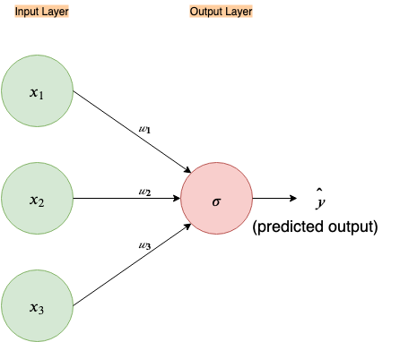
Approach 1: DNN on lagged features
Lagged features preform well with linear regression model. And single neuron NN represents simple linear regression.
We can consider it as our base model.
Adding hidden layers and nodes makes it ensemble of simple linear regression. Helps to improve the performance

Slide 7
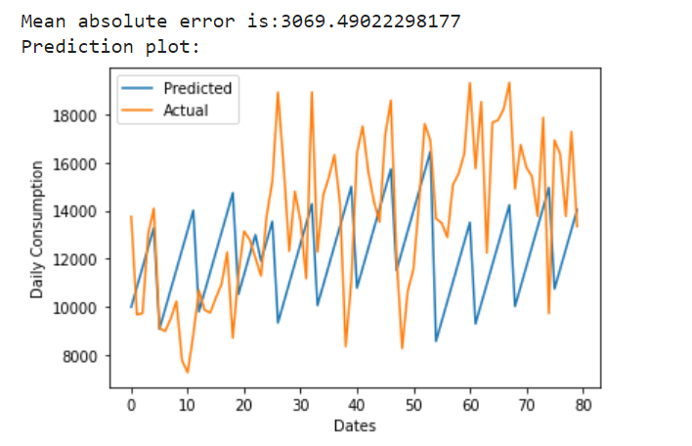
Single Node NN
Not a bad start
Next Changes:
Add Dummy variables
Play with hidden layers and hidden nodes

Slide 8
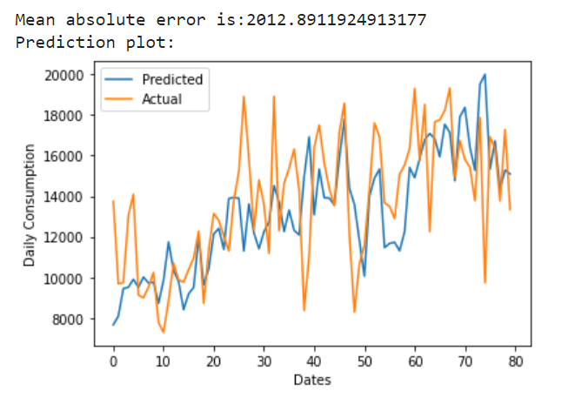
Single Node NN with Dummy variables
Exceptional improvement
It has captured base behavior very well. Doesn’t have huge difference at any time stamp

Slide 9
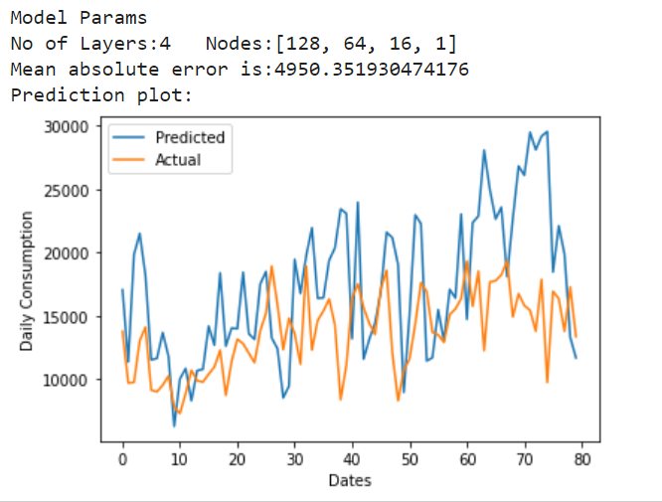
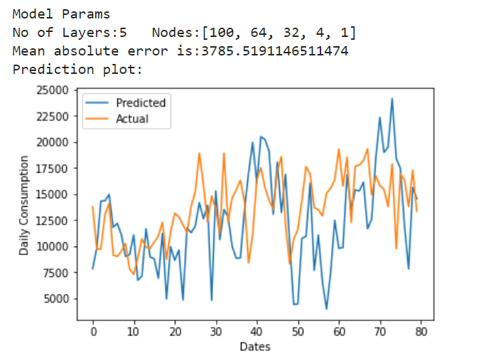
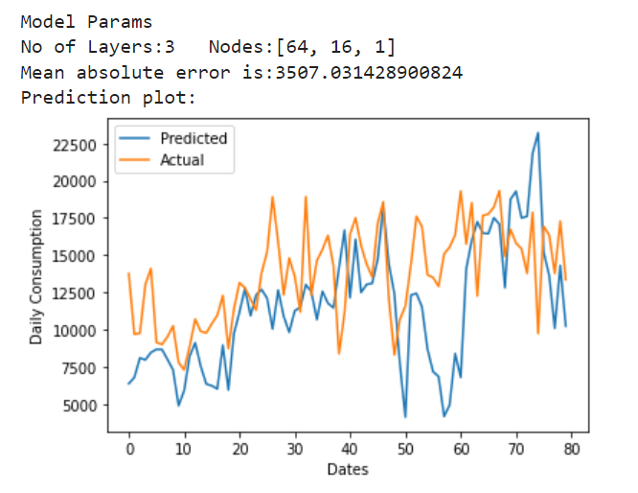
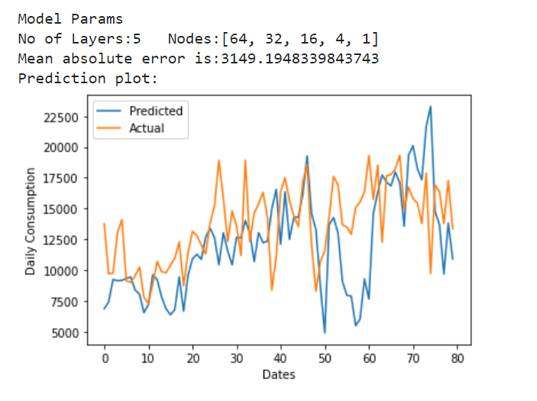
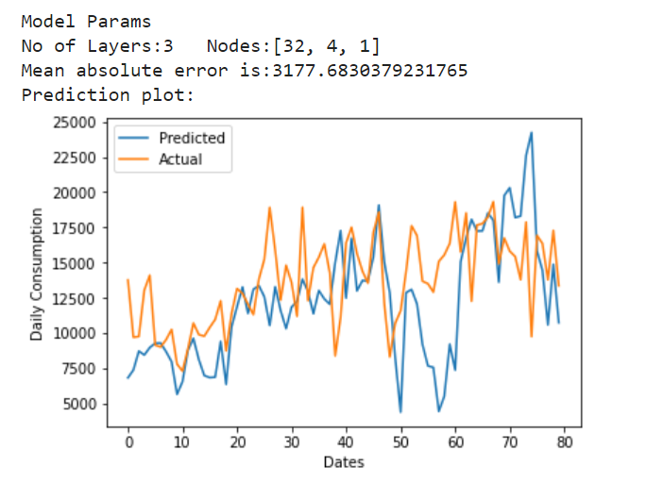
DNN: Check performances for different Layers , Nodes combination

Slide 10
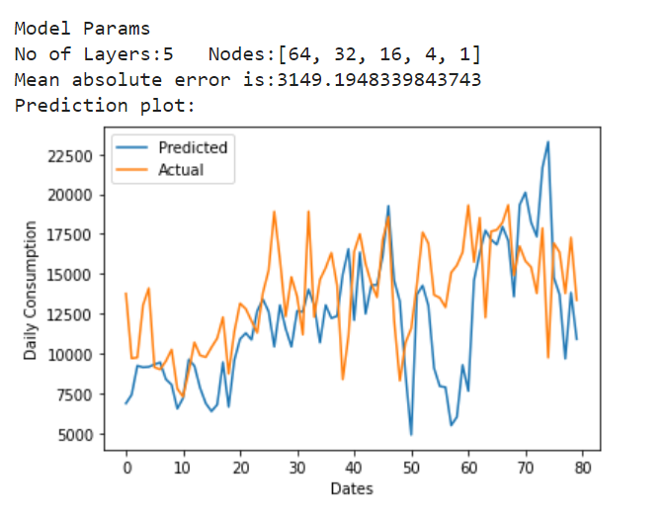
This combination perform well among all the combinations,
Still it is underperformed with single node.

Slide 11
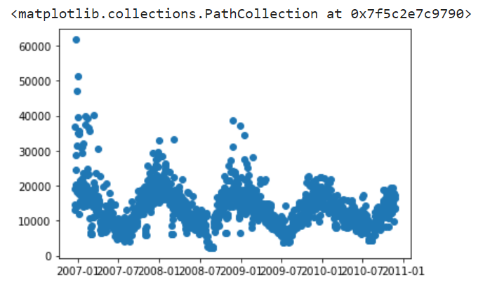
Approach 1:CNN on Windowed features
If we look at the Time Series Data, there are two major things to notice while creating window data
There is lot of noise
Season period is around 365 days
Considering these factors, window size of 80 and kernel size around 32 is selected

Slide 12
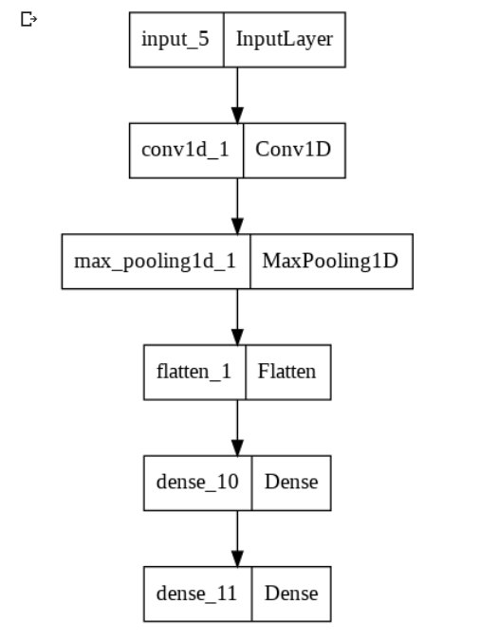
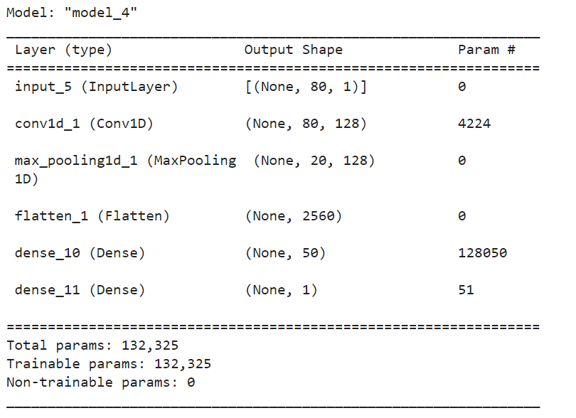
Model architecture

Slide 13
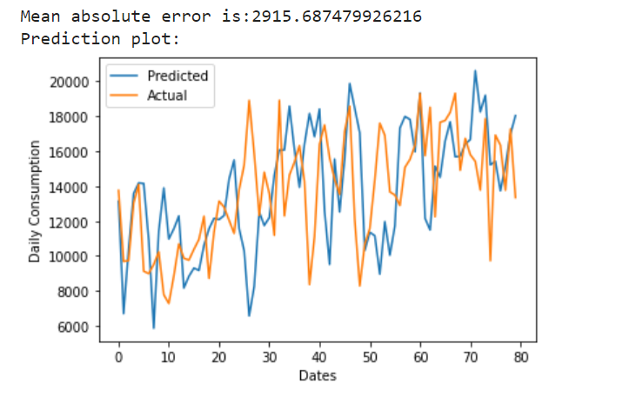
Result
Performed nice almost all the areas. Could capture sudden peaks, but for few peaks it has failed drastically.

Slide 14
Comparing results from two approaches
Approach 1 : DNN
MAE: 2012.89
Approach 2 : CNN
MAE: 2915.68
Approach 1 has better MAE value that approach 2. Approach 1 couldn’t capture the sudden spike but it learned the underlined behavior very well. Where as approach 2 is able to capture sudden spike for most of the times but it failed drastically in some cases and thus its MSE score is lower.
As the underline architecture is different, its result behavior is also different. That’s the beauty of ML, as different models approaches the problem differently.

Slide 15
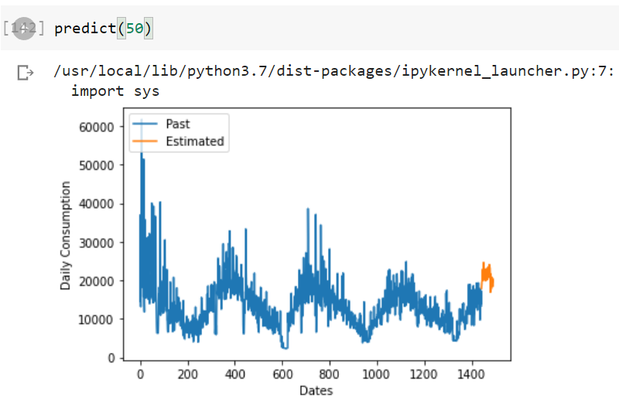
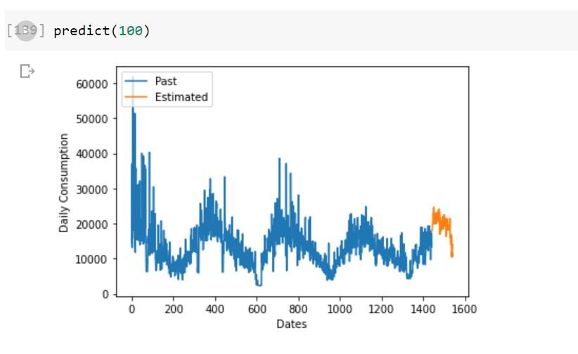
Consuming best model to predict future power consumption
Predicting Next 50 days consumption
Predicting Next 100 days consumption

Slide 16
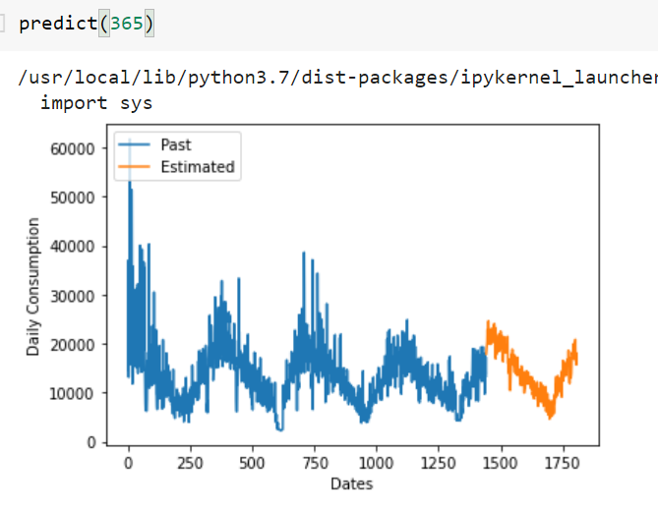
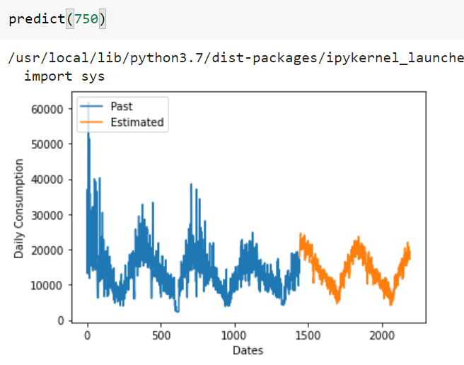
Predicting Next 2 years consumption
Predicting Next 1 year consumption

Slide 17
Thank you

